Slide 1
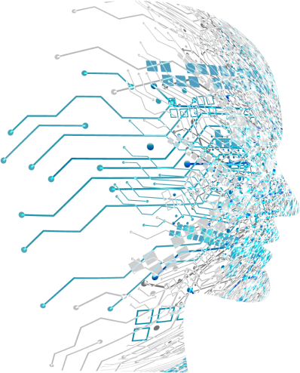
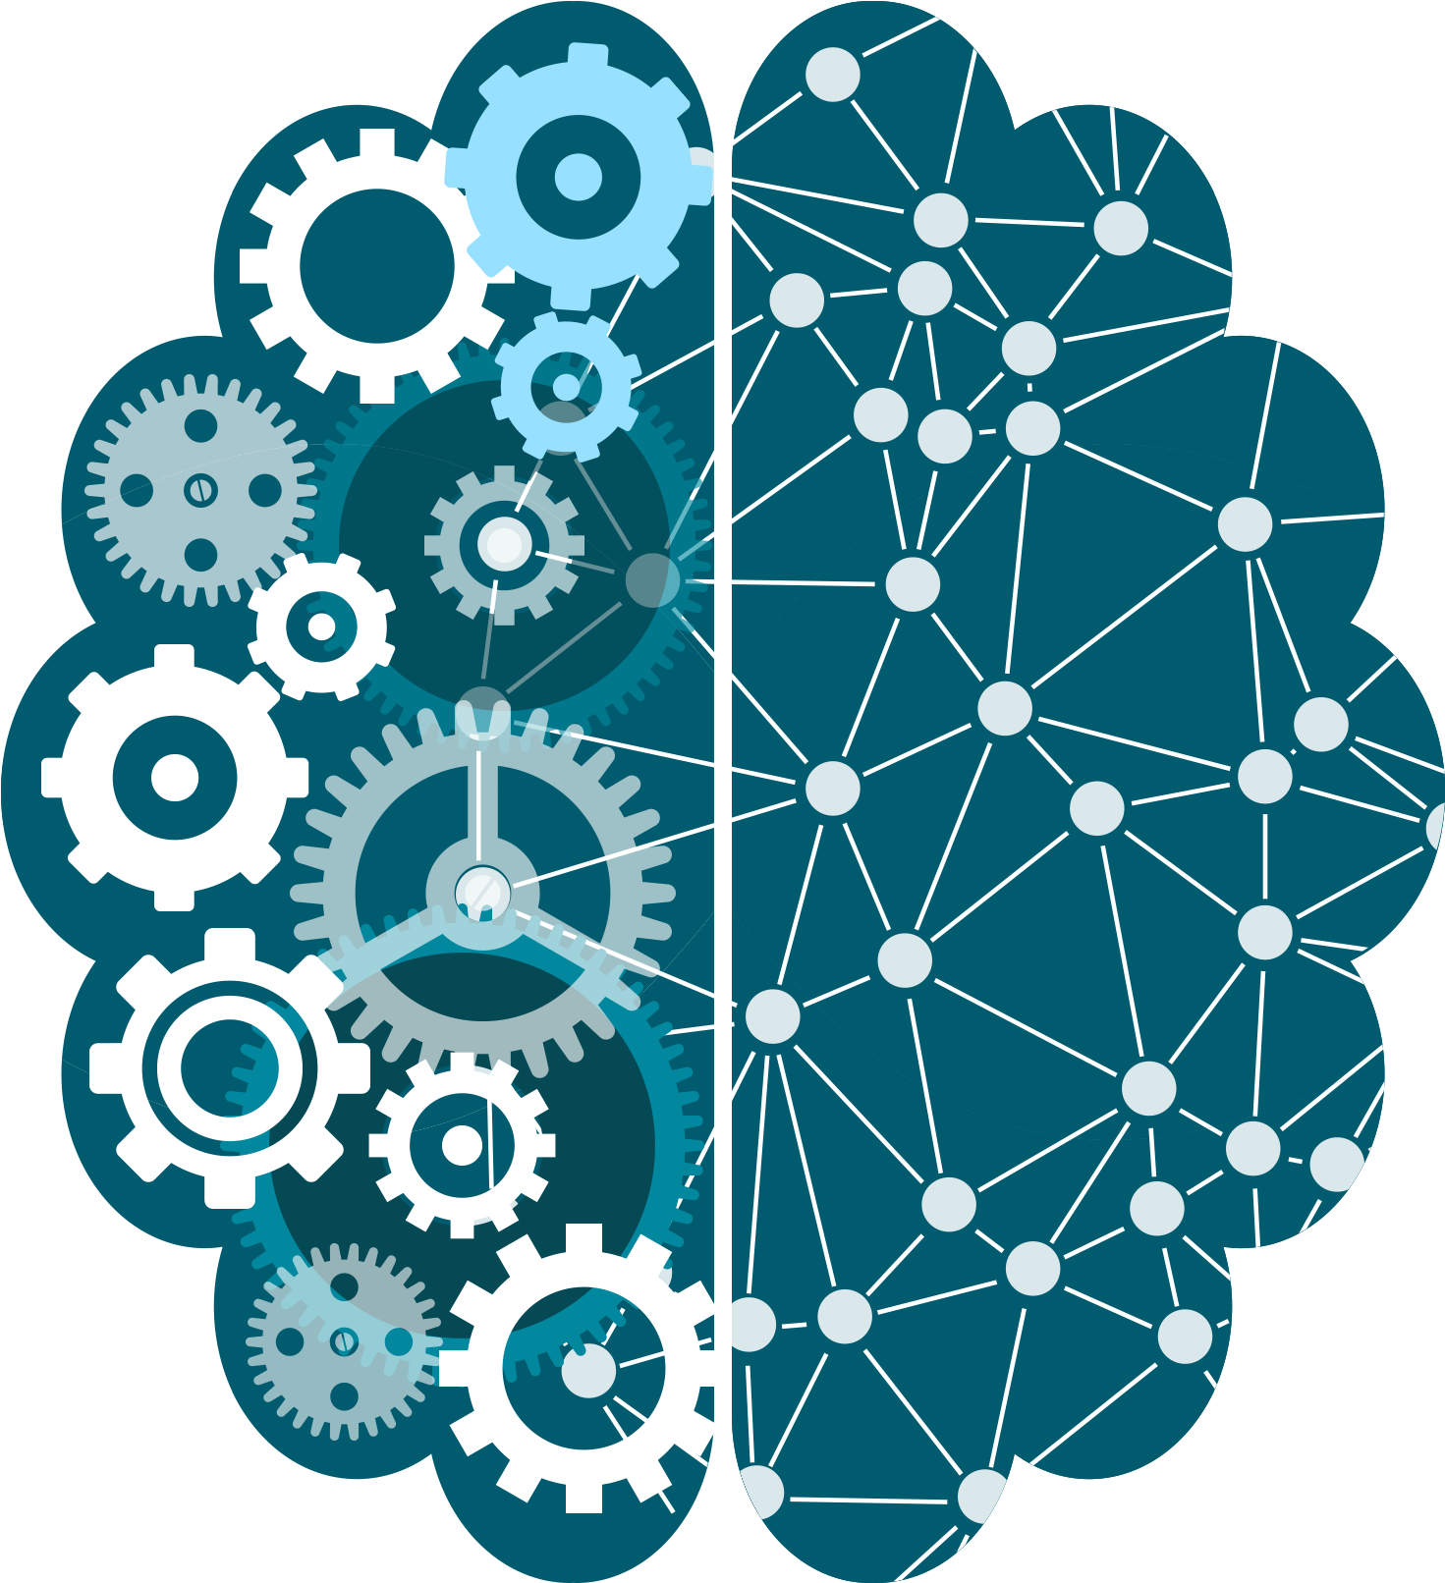
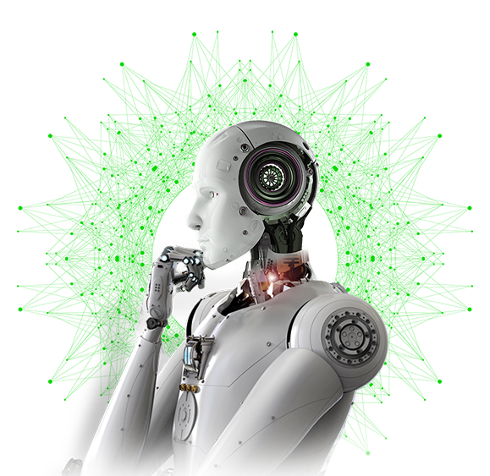
Data Science, Machine Learning & AI – an Overview
Ramanan Bhavanisankar
May 2023

Slide 2
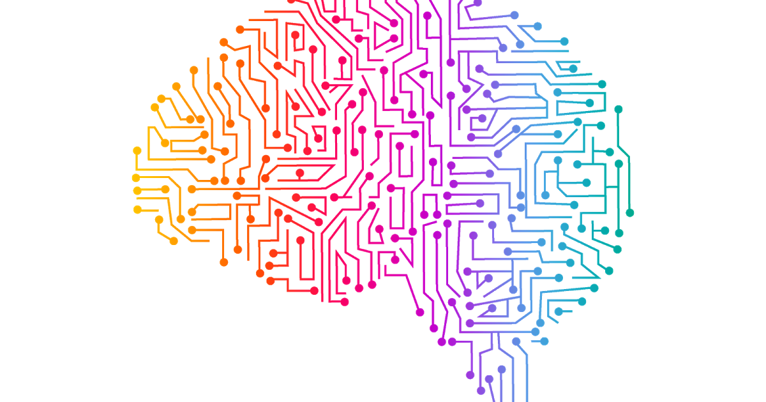
Table of Contents
Why the Hype?
Factors that have led to Data evolution
Data Science
Data Science Lifecycle
EDA - objectives
Correlation
Feature Engineering
Skills Required for Data Scientists

Slide 3
Table of Contents contd.
Artificial Intelligence
Artificial Intelligence – Key Components
AI, ML & Data Science – The Intersection
Machine Learning
Traditional Programming vs ML
Types of ML Algorithms
ML & RL Applications
ML Lifecycle
Model Evaluation Techniques

Slide 4



Why the

Slide 5





Factors that have led to the Big Data era, Multi-cloud era and Data evolution
Sophisticated Algorithms &
Techniques
Hardware
Computer Languages
Technological globalization

Slide 6
Data Science
Data science focuses on extracting knowledge or insights from structured, semi structured and unstructured data through various techniques, including statistical analysis, data visualization, and machine learning.
It involves collecting, processing, cleaning, and analyzing data to uncover patterns, trends, and correlations.
Data science encompasses a wide range of methodologies and tools to derive actionable insights from data.
The main goal of Data Science is Predictive analysis

Slide 7

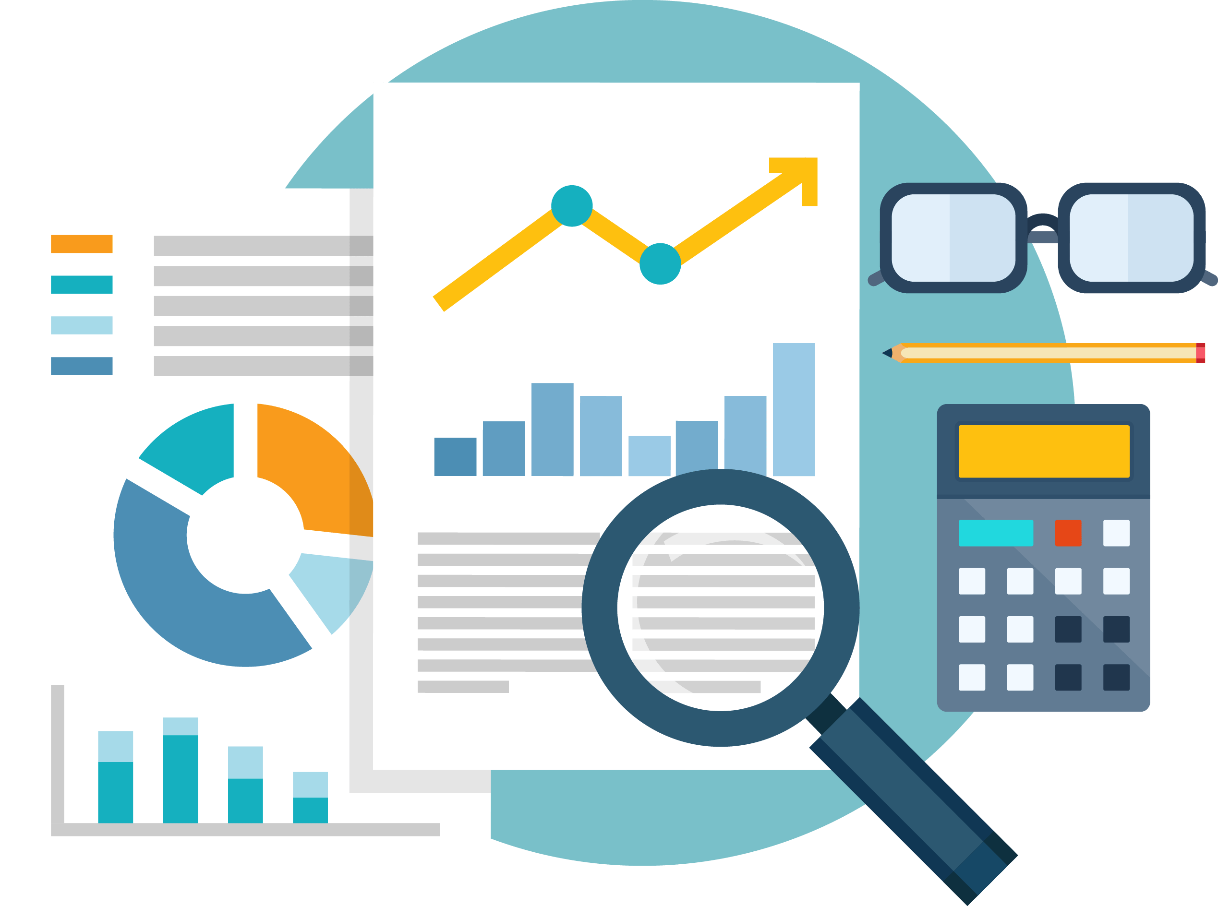


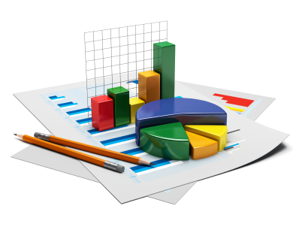



Data Science Lifecycle
1. Data Acquisition
2. Data Cleansing & Preprocessing
3. EDA
4. Feature Engineering
5. Statistical Analysis
6. Machine Learning
7. Model Evaluation & Validation
8. Deployment & Maintenance

Slide 8
Exploratory Data Analysis - Objectives
Confirm Data Relevancy
Missing Data
Duplicates
Incorrect values
Incorrect data types
Uncover and Resolve Data Quality issues
Data Summary
Mean, Median, Mode
Variance, SD, Skewness
Range, Sum, Count etc.,
Identify Outliers and Anomalies
Understand the correlation b/w the variables

Slide 9
Correlation
Correlation is used to measure the statistical relationship between two different variables (bivariate).
between the predictor variables
between the predictor and output/target variable
Helps to understand how the change in one parameter would impact the other parameter.
Correlation analysis is a very important concept in the field of predictive analytics.
The correlation coefficient is measured on a scale that varies from - 1 through 0 to + 1.
Complete/Perfect correlation between two variables is expressed by either + 1 or -1
+1 signifies perfect positive correlation
-1 signifies perfect negative correlation

Slide 10
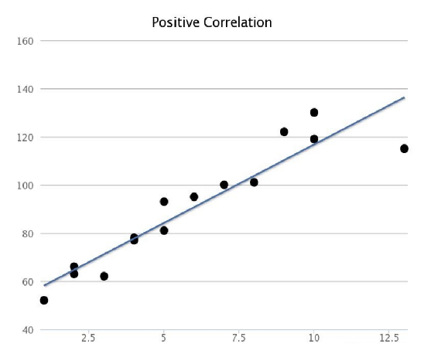
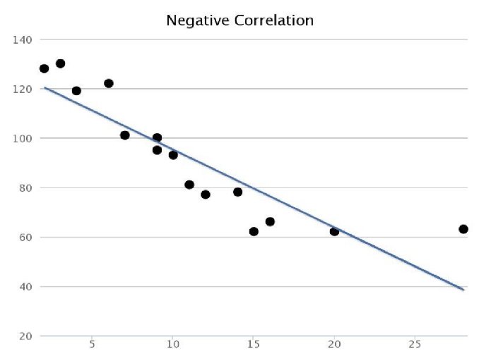
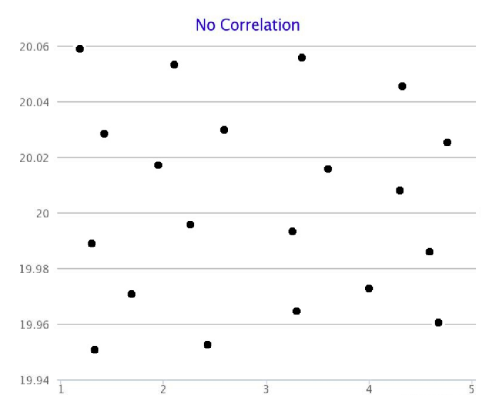
Types of Correlation
Positive Linear Correlation
There is a positive linear correlation when the variable on the x-axis increases as the variable on the y-axis increases. This is shown by an upwards sloping straight regression line.
Negative Linear Correlation
There is a negative linear correlation when one variable increases as the other variable decreases. This is shown by a downwards sloping straight regression line.
Zero Correlation
There is no relationship between the variables.

Slide 11
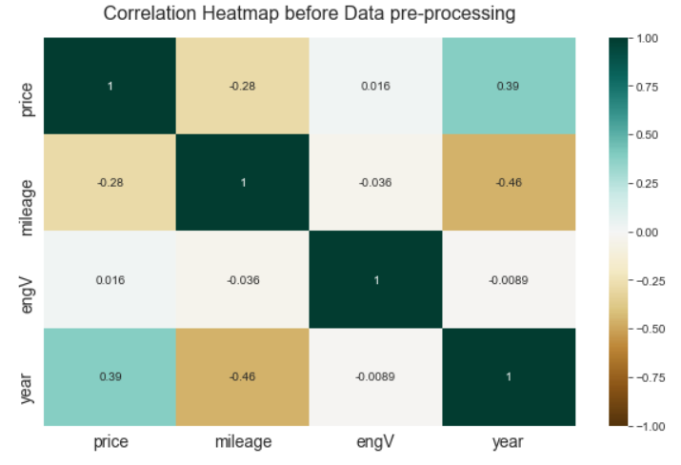
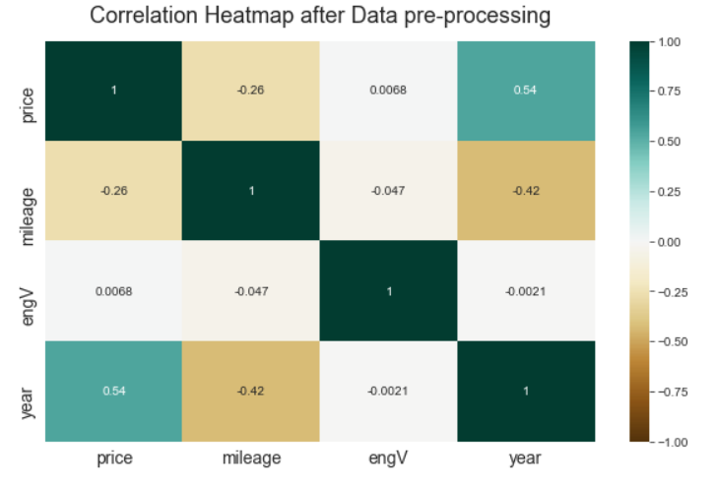
Correlation contd.
2 common methods used to visualize correlations are:
Scatter plot (refer to the previous slide)
Heat map - a graphical representation of data that uses a system of color-coding to represent different values.

Slide 12
Feature Engineering
Feature
Selection
What is a feature?
Generally, all machine learning algorithms take input data to generate the output. The input data remains in a tabular form consisting of rows (instances or observations) and columns (variable or attributes), and these attributes are often known as features. So, we can say a feature is an attribute that impacts a problem or is useful for the problem.
Feature
Creation/ Extraction
What is Feature Engineering?
Feature engineering is the pre-processing step of machine learning, which extracts features from raw data. It helps to represent an underlying problem to predictive models in a better way, which as a result, improve the accuracy of the model for unseen data. The predictive model contains predictor variables and an outcome variable, and while the feature engineering process selects the most useful predictor variables for the model.
Transformation

Slide 13
Skills required for Data Scientists
Technical
Non-Technical
Programming
Problem Solving
Probability & Statistics
DBMS
ETL
BI Tools for Visualization
Machine Learning Algorithms
Deep Learning
Handling semi/unstructured data
Model Evaluation
Model Deployment
Data Structures & Algorithms
Cloud Computing
Web Scraping
Strong Business Acumen
Communication Skills
Data intuition
Analytical skills
Critical Thinking
Decision Making
Presentation Skills

Slide 14
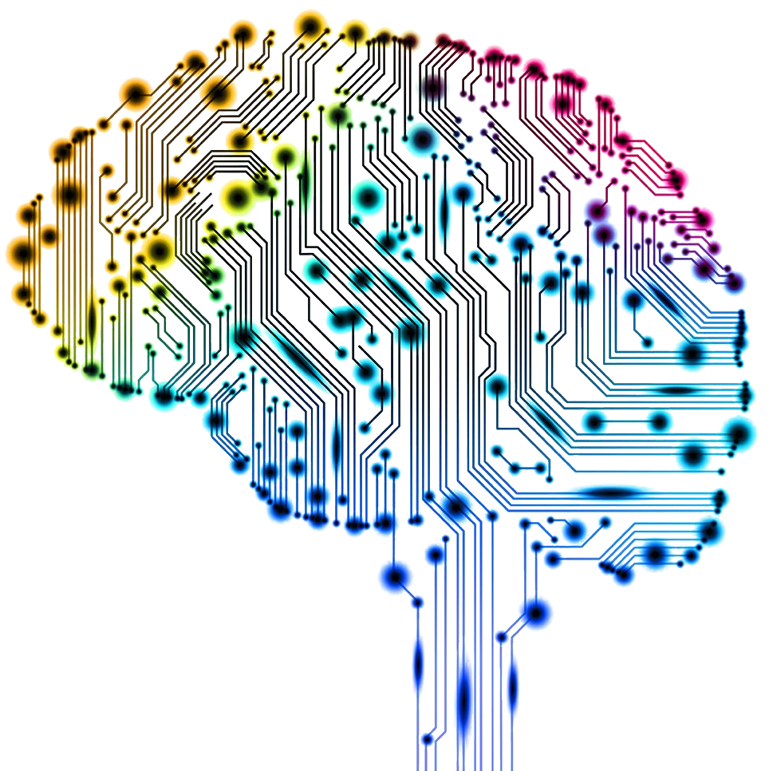
Artificial Intelligence
Artificial Intelligence (AI) refers to the simulation of human intelligence in machines that are programmed to perform tasks that typically require human intelligence.
AI aims to simulate human cognitive abilities, such as learning, reasoning, problem-solving, perception, and decision-making, using computer systems.

Slide 15
Artificial Intelligence – Key Components
Machine
Learning
Neural Networks
Development of algorithms and models that enable systems to learn from data and improve their performance without explicit programming.
They consist of interconnected nodes organized into layers. Neural networks are capable of learning complex patterns and relationships in data, making them a fundamental component of many AI applications.
Natural Language Processing
Robotics
NLP focuses on enabling computers to understand, interpret, and generate human language.
Robotics combines AI and physical systems to develop intelligent machines that are capable of perceiving, interacting with, and manipulating the physical world
Computer Vision
Expert Systems
Computer vision involves the processing, analysis, and understanding of visual data such as images and videos
AI systems that mimic human expertise in specific domains. They utilize knowledge bases, inference engines, and rule-based systems to solve complex problems and provide expert-level recommendations or solutions.

Slide 16
AI, ML and Data Science – The Intersection
Artificial
Intelligence
Machine
Learning
Deep
Learning
Data
Science

Slide 17

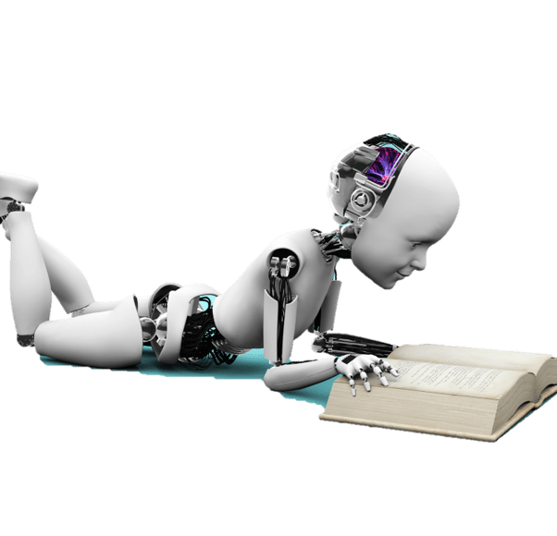
Machine Learning
Machine Learning (ML) is a subset of Artificial Intelligence (AI) that focuses on the development of algorithms and models that enable computer systems to automatically learn and make predictions or decisions without explicit programming.
ML algorithms learn patterns and relationships from data to improve their performance over time.

Slide 18
Traditional Programming vs Machine Learning
Traditional Programming
Data
COMPUTER
Output
Program
Machine Learning
Data
COMPUTER
Program
(for Predicting output on future data)
Output

Slide 19
Traditional Programming vs Machine Learning
Traditional Programming
Machine Learning
The programmer writes explicit rules or instructions to solve a specific problem. These rules are based on a predetermined logic or set of conditions.
ML takes a different approach by training models on data to learn patterns and make predictions or decisions. Instead of explicitly programming rules, ML algorithms automatically learn patterns from data and generalize them to make predictions on new, unseen data.
Traditional programs are well-suited for tasks with well-defined rules and structures. They are effective in scenarios where the input-output relationship is known and predictable.
Machine learning excels in handling complex and uncertain tasks. It can analyze large volumes of data, identify patterns, and make predictions or decisions based on probabilistic reasoning. ML models can adapt to new data and update their behavior, allowing them to handle dynamic and evolving scenarios.
May require extensive modifications or rewriting to adapt to new situations.
ML models have the ability to generalize from the training data and make predictions on new, unseen data. They can handle a wide range of inputs and generalize patterns to make predictions on similar examples. ML models are more scalable and can handle diverse and evolving datasets without significant reprogramming efforts.
Traditional programming involves a systematic and structured process of designing, coding, testing, and debugging the program to achieve the desired functionality. It requires a clear understanding of the problem domain and the logic required to solve it.
Machine learning development involves data collection, preprocessing, model selection, training, and evaluation. It requires a strong focus on data quality, feature engineering, and iterative experimentation to optimize the model's performance. The development process also includes fine-tuning the model parameters and monitoring its performance over time.

Slide 20
Types of Machine Learning Algorithms
Regression
Linear Regression
Decision Tree
Gaussian Regression
Supervised
Learning
Classification
Logistic Regression
Random Forest
K-nearest Neighbours
Naive Bayes
Decision Tree
Machine Learning
Unsupervised
Learning
Clustering
K-Means
K-Medoids
Mean-Shift Clustering
Reinforcement
Learning
Dimensionality
Reduction
Feature Selection
Principle Component
Analysis
Factor Analysis

Slide 21
Types of Machine Learning Algorithms contd.
Supervised Machine Learning
A supervised learning algorithm takes a known set of input data (the learning set) and known responses to the data (the output) and forms a model to generate reasonable predictions for the response to the new input data. Use supervised learning if you have existing data for the output you are trying to predict. They can be for Classification or Regression use cases.
Unsupervised Machine Learning
Unsupervised machine learning is a type of machine learning where the algorithms learn patterns, structures, or relationships in unlabeled data without any predefined target or output variables. Unlike supervised learning, unsupervised learning algorithms aim to discover patterns, structures, or relationships within the data on their own. These algorithms explore the data and extract meaningful information without any prior knowledge or guidance.

Slide 22
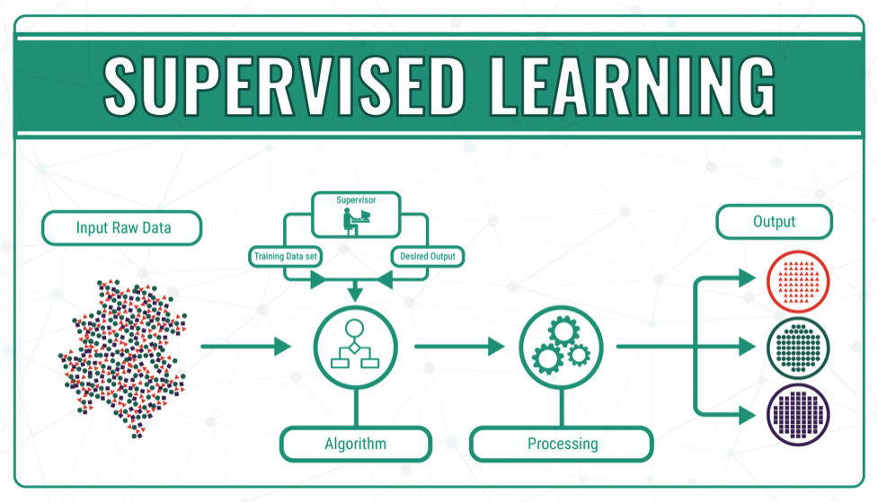
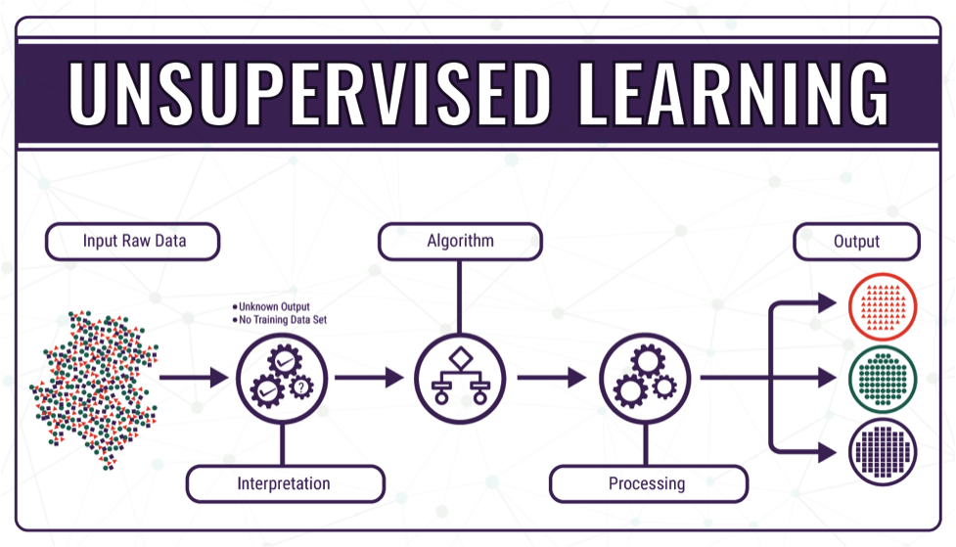
Types of Machine Learning Algorithms contd.

Slide 23
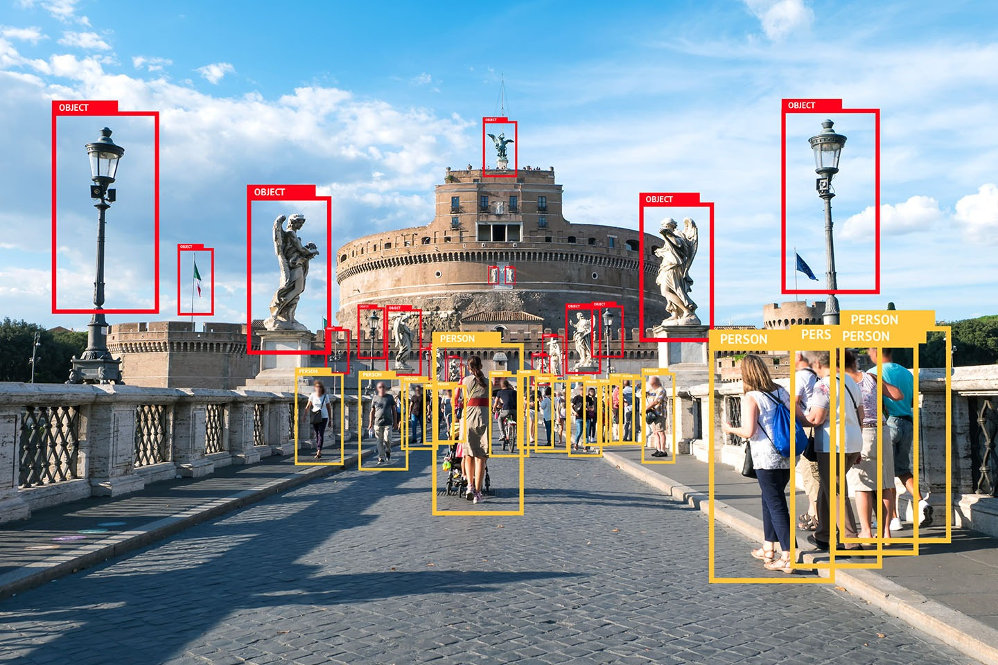
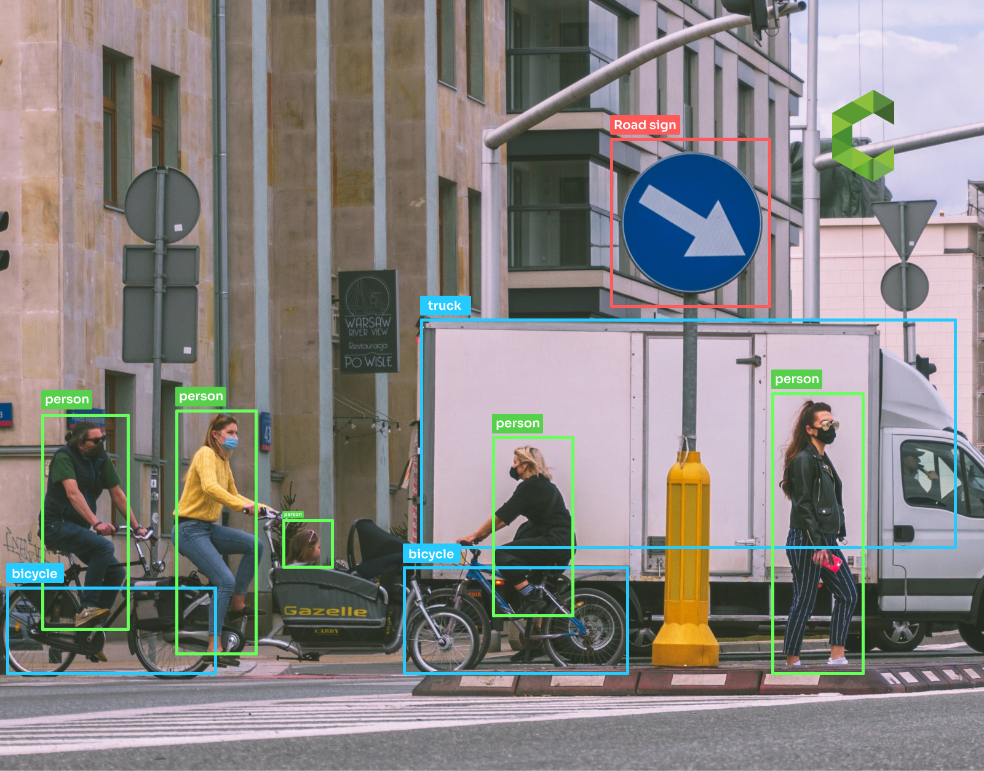
Types of Machine Learning Algorithms contd.
Image segmentation/recognition example

Slide 24
Types of Supervised Learning algorithms
Regression Algorithms
Regression algorithms are used when the output variable is continuous or numerical, representing a range of possible values.
The goal of regression is to predict a numerical output value based on the input features and establish a relationship between them.
Classification Algorithms
Classification algorithms are used when the output variable is categorical or discrete, representing different classes or categories. These algorithms learn from labeled training data, where each data point is associated with a known class or category. The goal of classification is to build a model that can accurately assign new, unseen data points to the correct class based on their input features.

Slide 25
Types of Unsupervised Learning algorithms
Clustering Algorithms
Using a clustering algorithm means you're going to give the algorithm a lot of input data with no labels and let it find any groupings in the data it can.
Those groupings are called clusters. A cluster is a group of data points that are similar to each other based on their relation to surrounding data points. Clustering is used for pattern discovery.
Dimensionality Reduction Algorithms
Dimensionality reduction is a technique used to reduce the number of features in a dataset while retaining as much of the important information as possible. In other words, it is a process of transforming high-dimensional data into a lower-dimensional space that still preserves the essence of the original data. In machine learning, high-dimensional data refers to data with a large number of features or variables. ‘The curse of Dimensionality’ – Model performance deteriorates with overwhelming features.

Slide 26
Types of Unsupervised Learning algorithms contd.
Dimensionality Reduction Algorithms contd.
The complexity of the model increases with the number of features, and it becomes more difficult to find a good solution. In addition, high-dimensional data can also lead to overfitting, where the model fits the training data too closely and does not generalize well to new data.

Slide 27





ML Applications
Supervised
Unsupervised
Regression
Classification
Clustering
Dimensionality
Reduction
Financial forecasting (like house price estimates, or stock prices)
Image Retrieval
Gene Expression Analysis
Intrusion Detection
Neuroscience
Customer segmentation
Document clustering
Image Segmentation/ Recognition
Fraud detection
Spam filtering
Medical diagnostic test

Slide 28
Types of Machine Learning Algorithms contd.
Reinforcement Learning
Reinforcement Learning is a feedback-based Machine learning technique in which an agent learns to behave in an environment by performing the actions and seeing the results of actions.
For each good action, the agent gets positive feedback, and for each bad action, the agent gets negative feedback or penalty.
In Reinforcement Learning, the agent learns automatically using feedbacks without any labeled data, unlike supervised learning.
Since there is no labeled data, so the agent is bound to learn by its experience only.
RL solves a specific type of problem where the goal is long-term, such as game-playing
The agent interacts with the environment and explores it by itself.
The primary goal of an agent in reinforcement learning is to improve the performance by getting the maximum positive rewards.

Slide 29
Types of Machine Learning Algorithms contd.
Key Features of Reinforcement Learning
In RL, the agent is not instructed about the environment and what actions need to be taken.
It is based on the hit and trial process.
The agent takes the next action and changes states according to the feedback of the previous action.
The agent may get a delayed reward.
The environment is stochastic, and the agent needs to explore it to reach to get the maximum positive rewards.
RL is a core part of Artificial intelligence, and all AI agent works on the concept of reinforcement learning. Here we do not need to pre-program the agent, as it learns from its own experience without any human intervention.

Slide 30

Applications of RL
Applications in self-driving cars
In self-driving cars, there are various aspects to consider, such as speed limits at various places, drivable zones, avoiding collisions — just to mention a few.
Reinforcement Learning applications in trading and finance
Supervised time series models can be used for predicting future sales as well as predicting stock prices. However, these models don’t determine the action to take at a particular stock price. An RL agent can decide on such a task; whether to hold, buy, or sell. IBM for example has a sophisticated reinforcement learning based platform that has the ability to make financial trades. It computes the reward function based on the loss or profit of every financial transaction.
Reinforcement Learning in NLP (Natural Language Processing)
In NLP, RL can be used in text summarization, question answering, and machine translation just to mention a few.
is designed based on hybrid model of supervised ML and RL

Slide 31
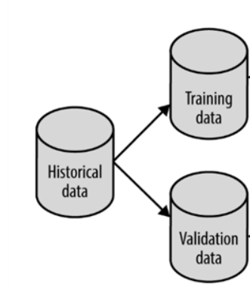
Machine Learning Lifecycle
Data
Acquisition
EDA
&
Feature Engineering
Model
Selection
Training
Test/Cross
Validation
Model
Evaluation
Parameter
Tuning
Model
Deployment
Monitor
Maintain
Improvise
Optimize

Slide 32
ML Model Evaluation Techniques
Root mean squared error (RMSE)
AUC-ROC curve
Logarithmic loss
Kappa score
Confusion matrix
Kolmogorov-Smirnov Test
Cross-validation techniques
Gini coefficient
Gain and lift chart
Chi-square test
Brier score

